Slide 1
Foreign Key

Slide 2
What is foreign key?
A FOREIGN KEY is a field (or collection of fields) in one table, that refers to the PRIMARY KEY in another table.
The table with the foreign key is called the child table, and the table with the primary key is called the referenced or parent table.

Slide 3
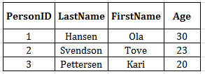
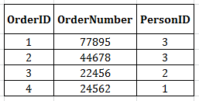
Examples
Notes:
Notice that the "PersonID" column in the "Orders" table points to the "PersonID" column in the "Persons" table.
The "PersonID" column in the "Persons" table is the PRIMARY KEY.
The "PersonID" column in the "Orders" table is a FOREIGN KEY.
The FOREIGN KEY constraint prevents invalid data from being inserted into the foreign key column, because it has to be one of the values contained in the parent table.

Slide 4
Query
CREATE TABLE Orders (
OrderID int NOT NULL,
OrderNumber int NOT NULL,
PersonID int,
PRIMARY KEY (OrderID),
FOREIGN KEY (PersonID) REFERENCES Persons(PersonID)
);

